Slide 1

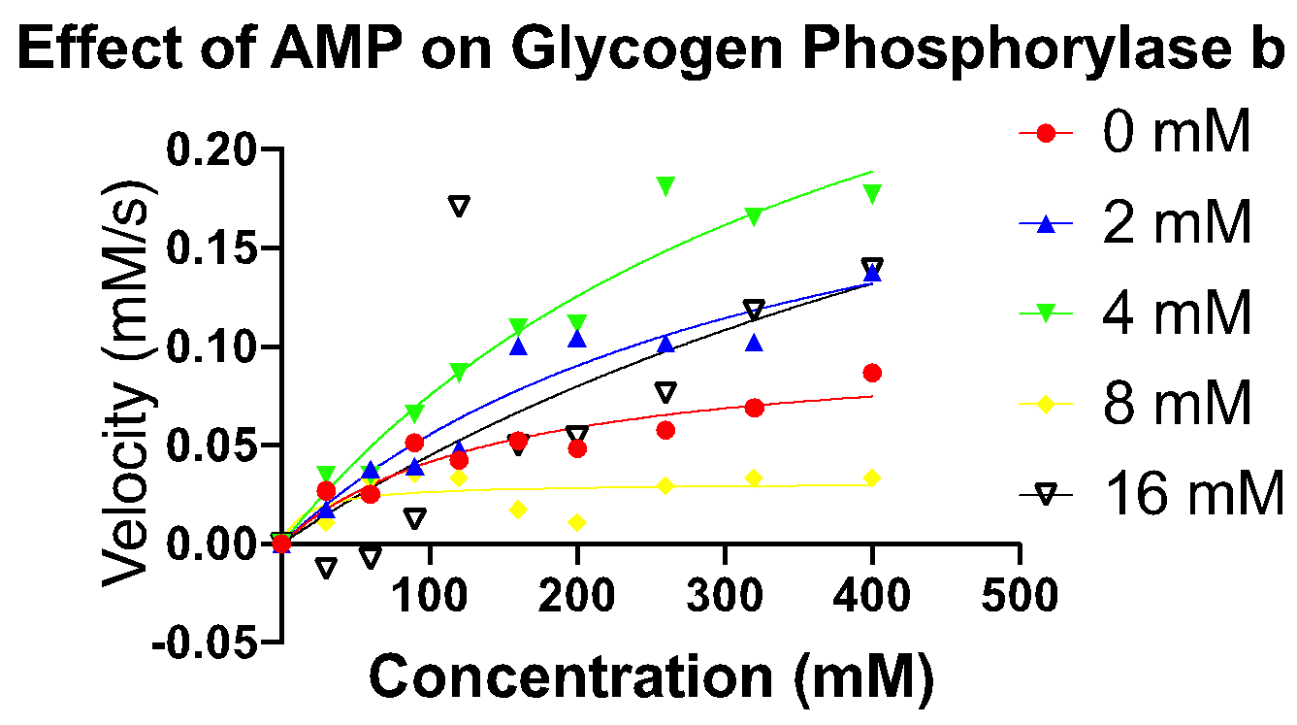
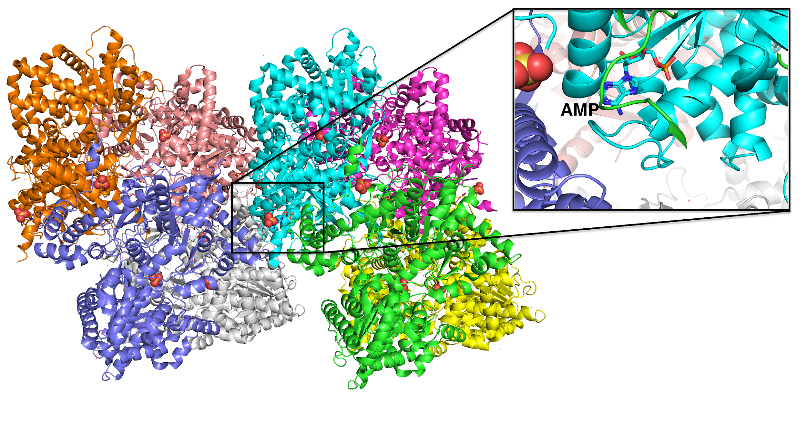
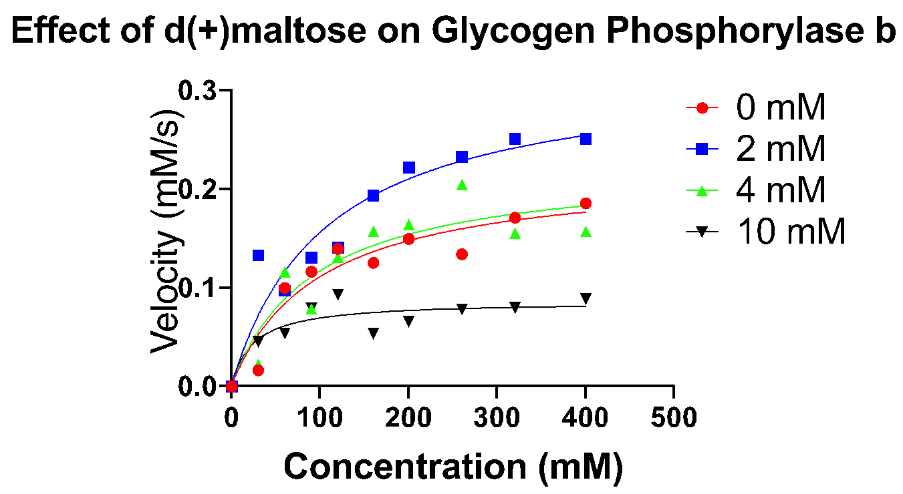
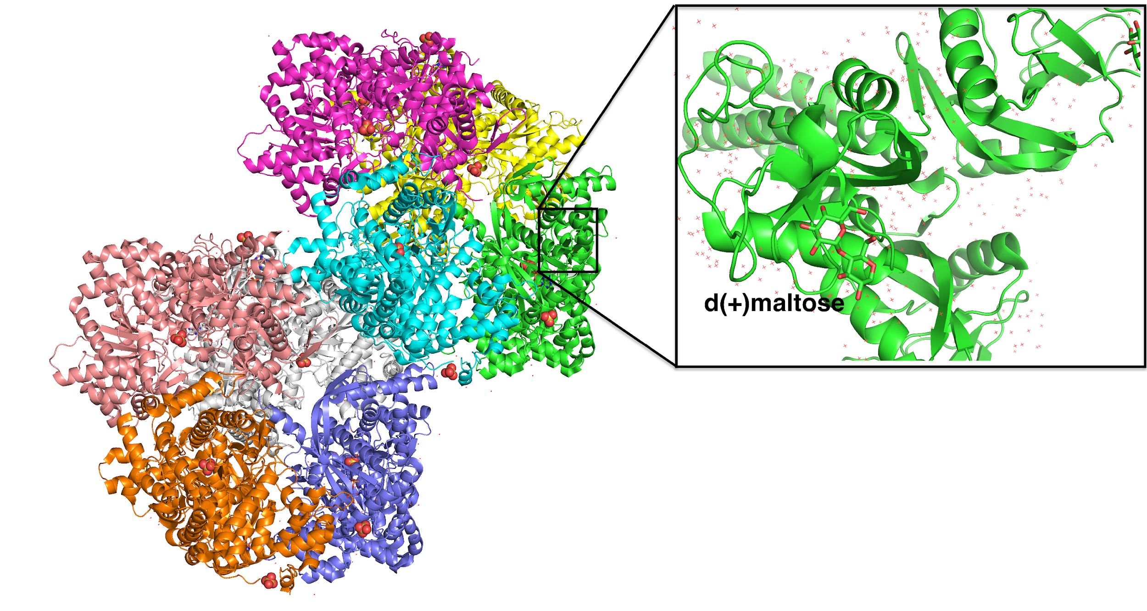
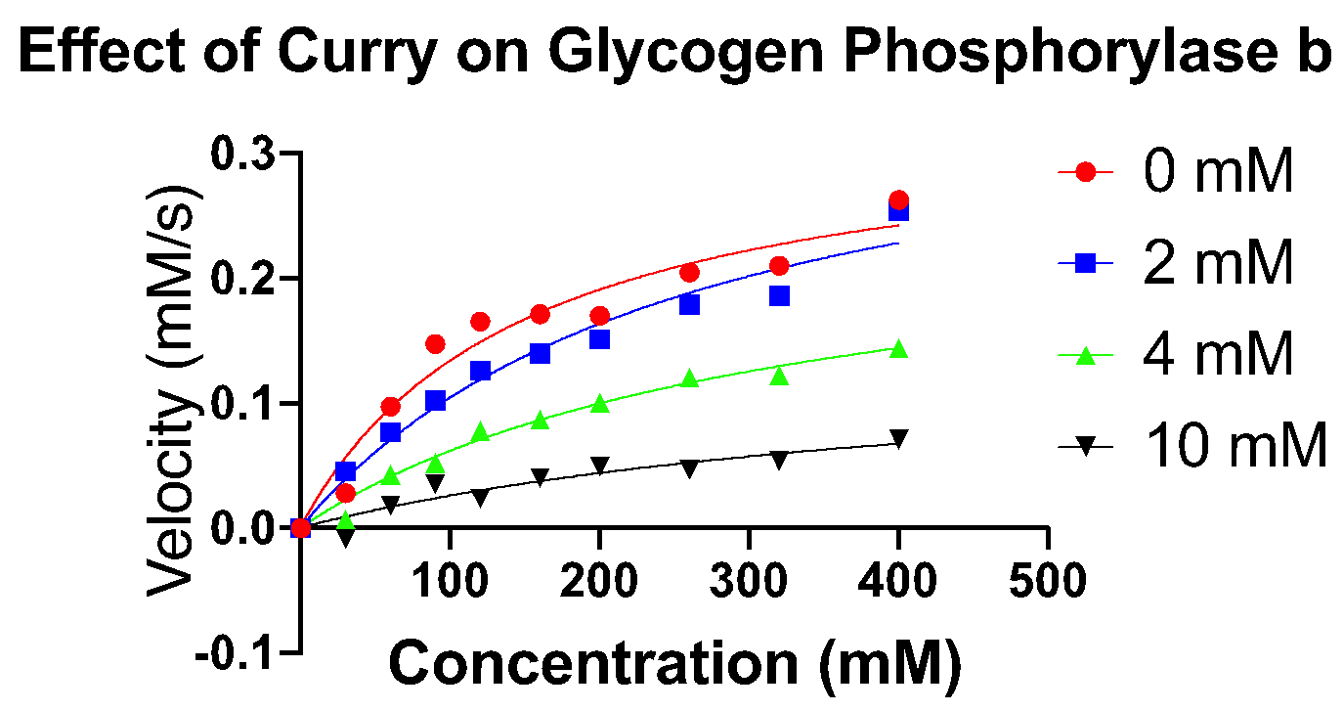
The Effect of D(+)maltose and Curry on Glycogen Phosphorylase b
Alhamzah Y. Hamzah, Alexander Michael Bowman, Roberto N. De Guzman
Department of Molecular Biosciences University of Kansas, Lawrence, KS 66045, USA
Abstract:
Aim of Study:
Approach:
Glycogen phosphorylase b is an inactive enzyme that is involved in the glycogen metabolism. Fluorescence spectroscopy was applied on the enzyme to identify molecular components of glycogen phosphorylase b. Its molecular components contain dimer of two identical subunits. It does not contain a phosphate group which makes it different from glycogen phosphorylase a (the active form). Glycogen phosphorylase b is commonly found in the liver, where glucose gets stored as glycogen. The experiment was done on glycogen phosphorylase b to analyze its reaction toward d(+)maltose and Curry. To analyze it’s activity, we measured the absorbance of an inorganic phosphate. D(+)maltose and Curry were used at different concentrations to find out if d(+)maltose and Curry act as an inhibitor or activator by analyzing the change in Michaelis-Menten curve. After analyzing the data that was collected, both d(+)maltose and curry acts as an inhibitor.
To study the affection of d(+)moltose, AMP and Curry on glycogen Phosphorylase b
Using Fluorescence and Allosteric regulation to determine the velocity of the enzyme in the percent of the effectors.
Results:
Background:
Graph 1: AMP speeds up glycogen phosphorylase b activity.
Figure 1: AMP binds to glycogen phosphorylase b and acts as an activator ().
Graph 2: D(+)maltose slows down glycogen phosphorylase b activity.
Graph 3: Curry slows down glycogen phosphorylase b activity.
Conclusions:
Glycogen phosphorylase b is involved in the glycogen metabolism that gets regulated by three allosteric regulators (AMP, d(+)maltose and Curry).
Figure 2: D(+)maltose binds to glycogen phosphorylase b and act as an inhibiter ().

